Slide 1
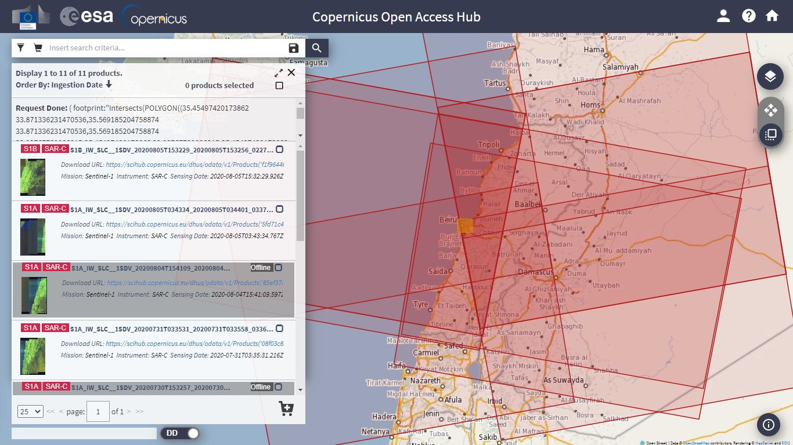
Relative Orbit selection
From Copernicus Open Data Hub

Slide 2
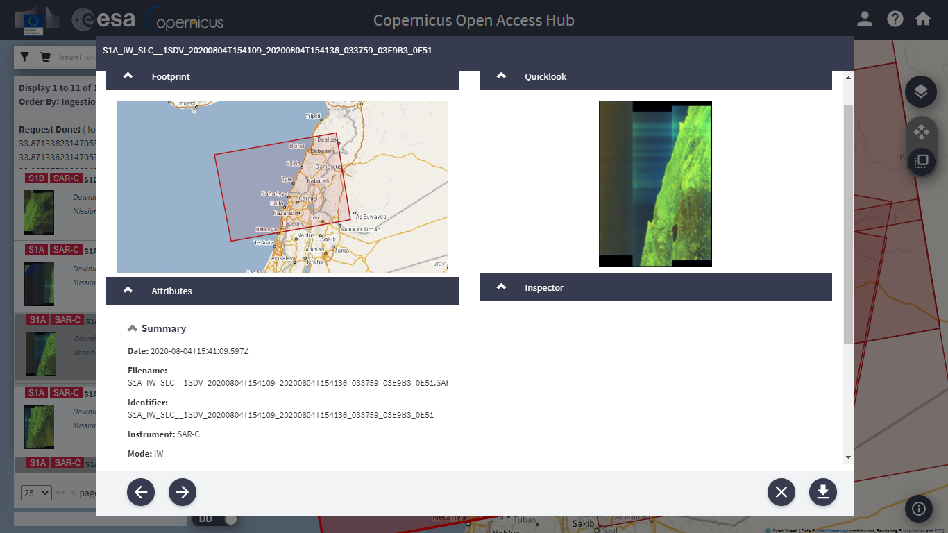
Relative Orbit selection

Slide 3
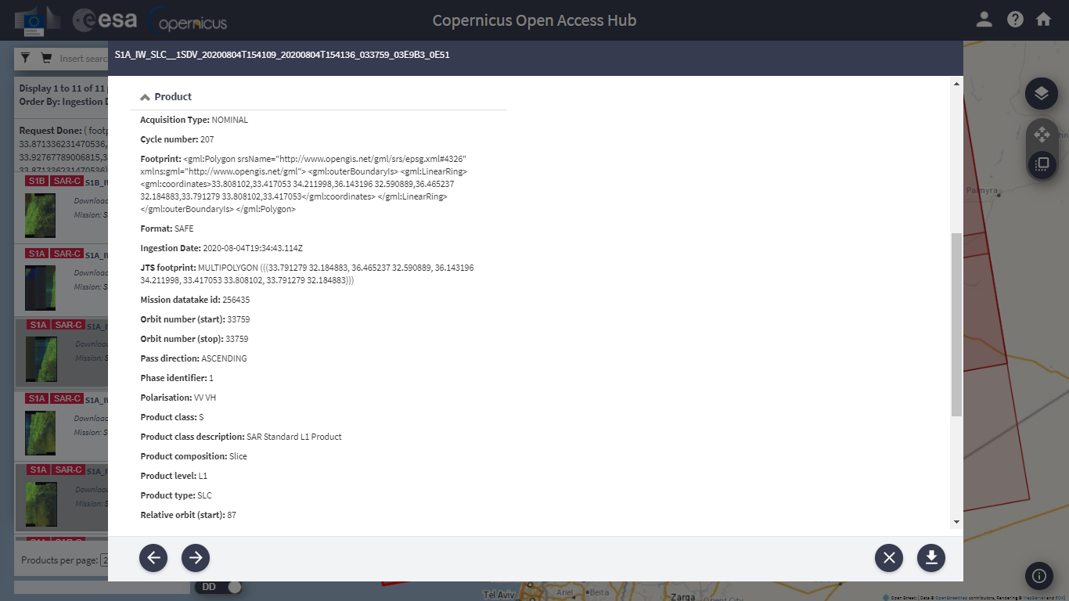

Relative Orbit selection

